Slide 1
Negotiations – Communications and the Media
March 13, 2018
Peter Fagen
Partner

Slide 2
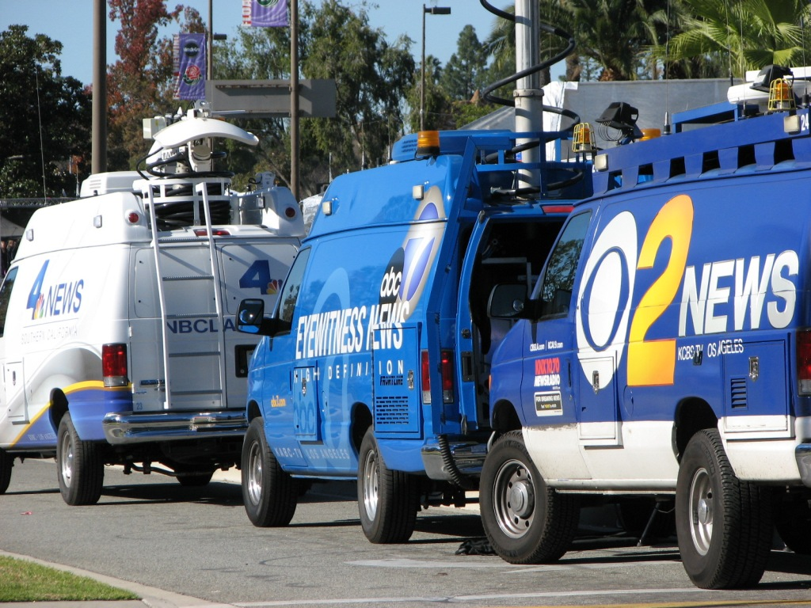

Slide 3
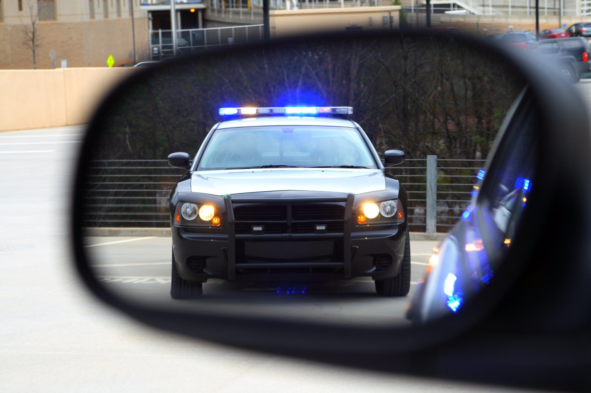

Slide 4
Today: Issues and Incidents
Preparing Messages
Working with the Media
Protecting Privacy

Slide 5
Message Development
What they need to hear
What you need to say
Tough questions
Speak to a parent

Slide 6
Statement/Message Development
Connect/confront, clarify and accountability
What they need to hear
What you need to say
Anticipate the most difficult questions
Tell the truth, say it first
See the bigger picture

Slide 7
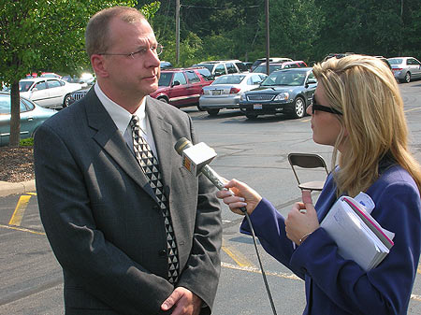
Holding Statement v Press Release

Slide 8
C
A
S
E
S
T
U
D
Y
Issue / Incident
Facts
Primary grade student walking to school with group of children
Hit near school by an automobile that fled the scene
Child died at the hospital
Have not yet heard from the media
City/district “disputing” funding for crossing guards

Slide 9
Tough Questions

Slide 10
Student Killed, Hit and Run
With profound sadness, I must inform our community a (school name) student was the tragic victim of a hit and run while walking to school this morning. The child, whose name is being withheld from district statements based on the family’s request for privacy, was transported by emergency services to X Hospital. His family was by his side when he passed away.
This tragedy took place at (location) at approximately (time). At this time, local law enforcement is aggressively searching for the driver of (car), and anyone with information that may help the investigation is urged to contact.
District counselors and support staff are on campus to provide additional … I will provide our school community with information on immediate steps that we will be taking to examine pedestrian safety. At this time, I ask everyone to join me in respecting the family’s privacy.

Slide 11
Tough Questions/Transitions
(A) Our school community lost a child, which is devastating… and that question comes from pain, fear and anger… (B) and I understand the parent’s anger… (C) the City Manager and I are meeting to…

Slide 12
Dissemination: Think & Act In “Circles”
Choose words/tone from the outside in.
Community &
Media
Parents
1) Site Administrators & Union Leadership 2) Staff
Empathy
Humility
Accessible
Confident
Cabinet
Superintendent &
Board

Slide 13
Working With The Media

Slide 14
Read Your Prepared Statement

Slide 15
Media
Questions provide an opportunity for more than just an answer
Have two or three points that you want to make
Focus on what you are doing
Prepare, rehearse ATMs

Slide 16
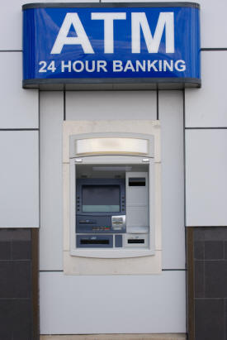
ATM
Acknowledge
Transition
Message

Slide 17
Interview Tips
Stick to the messages
Have two or three points that you want to make
Acknowledge question and pivot to message
Question is opportunity to make your point
Repeat, until the interview concludes
Audience – not reporters, your school community
Calm, confident, empathic leadership
Pause
Do not speculate
Do not answer for others
Practice
Body language is over 80% of what people hear
Look at reporter, not camera, minimize blinking
Yes/No Questions

Slide 18
Communication Protocols
Internal / External:
Establish a protocol for notifying people when incidents occur
Use ongoing communication modes to clarify this process
“Situation Updates”

Slide 19
Monitor: Follow-Up Communication
The next day
Circles – message points
Staff messages
Office manager
How to handle media
Message to parents – preparing students to return

Slide 20
Privacy Pointers
Review messages with employees/parents
Student and employee-specific issues
Meet with staff
Hear their questions/ engage their support
Circles
Know where to send parent Qs
When you cannot offer names, explain why

Slide 21
Tips for Tough Situations
Meet with staff
Consider meeting with lead parents
Do not surprise the union
Take messages to 30,000 feet
Correct media inaccuracies (circles)

Slide 22
Information in this presentation, included but not limited to PowerPoint handouts and the presenters’ comments, is summary only and not legal advice.
We advise you to consult with legal counsel to determine how this information may apply to your specific facts and circumstances.

